Slide 1

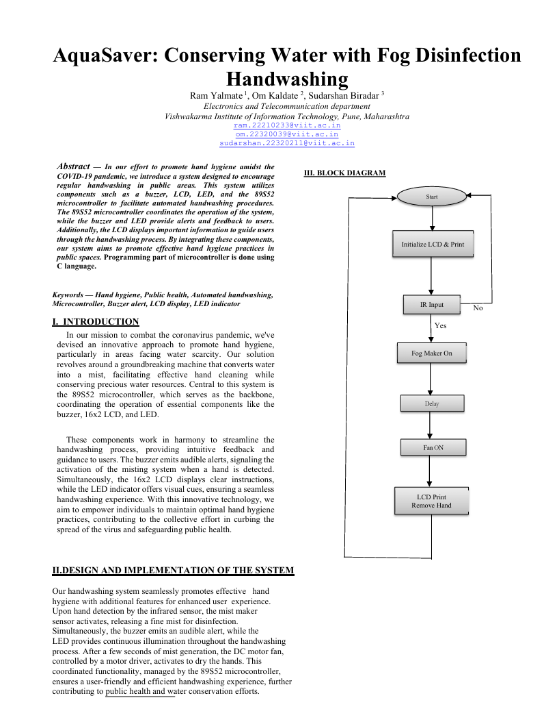
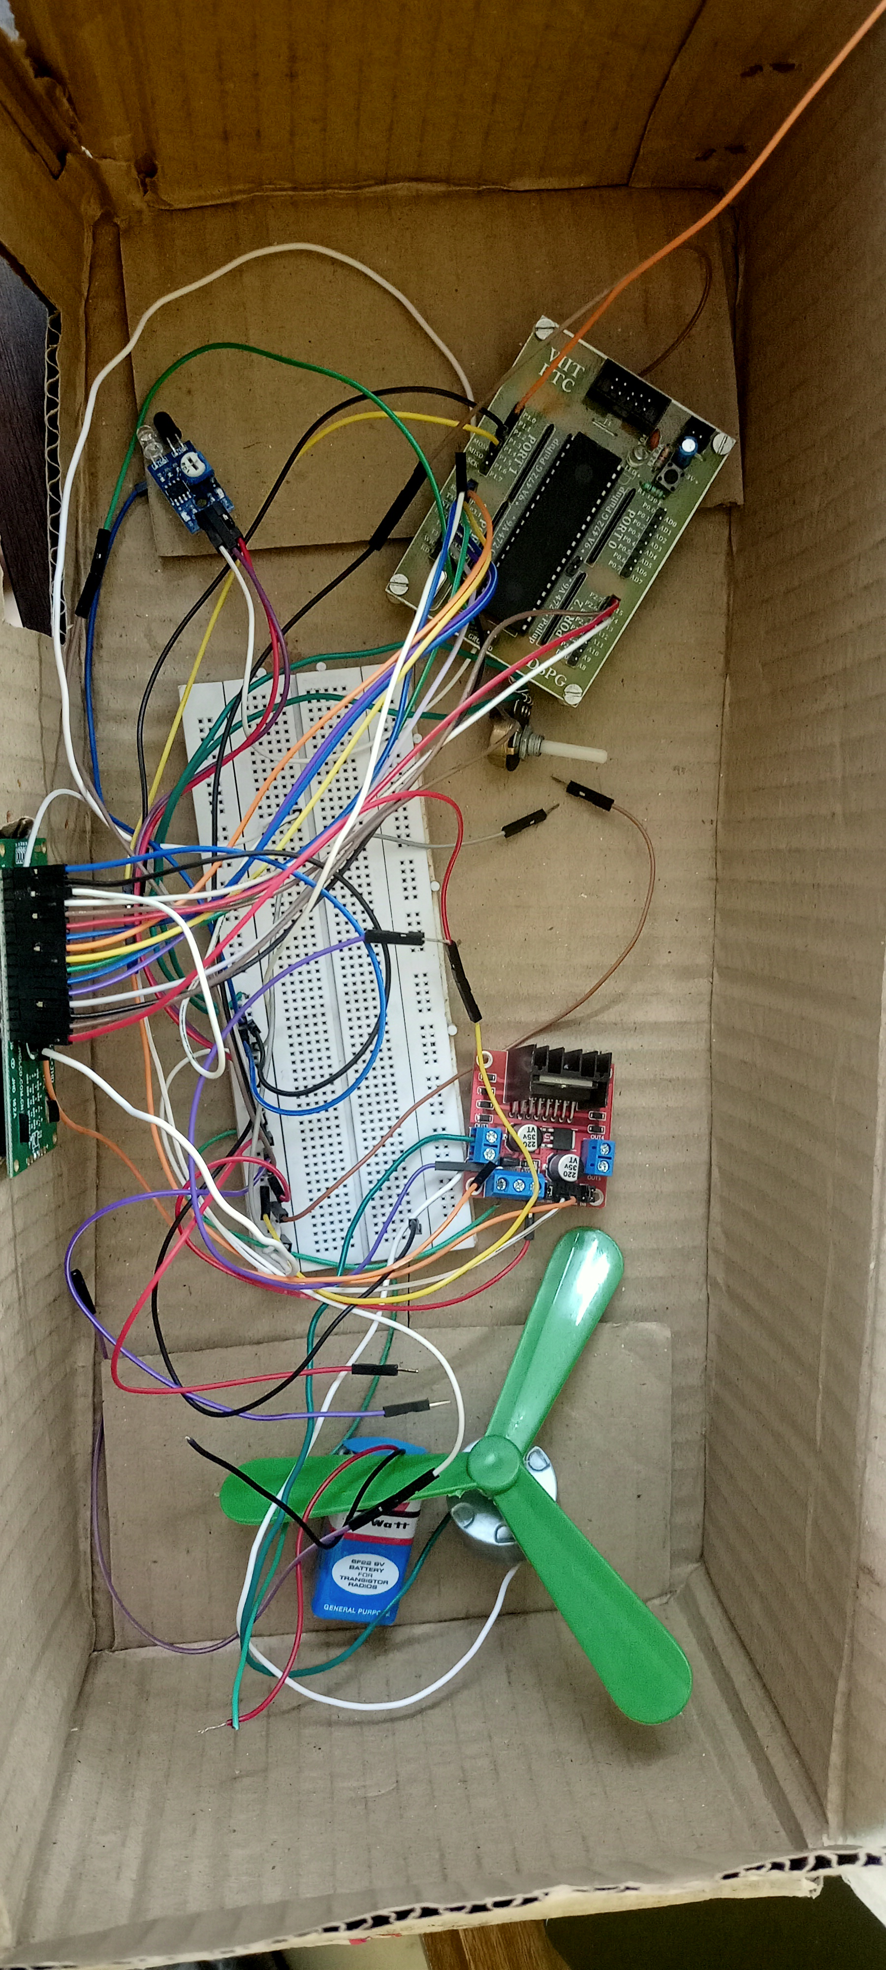
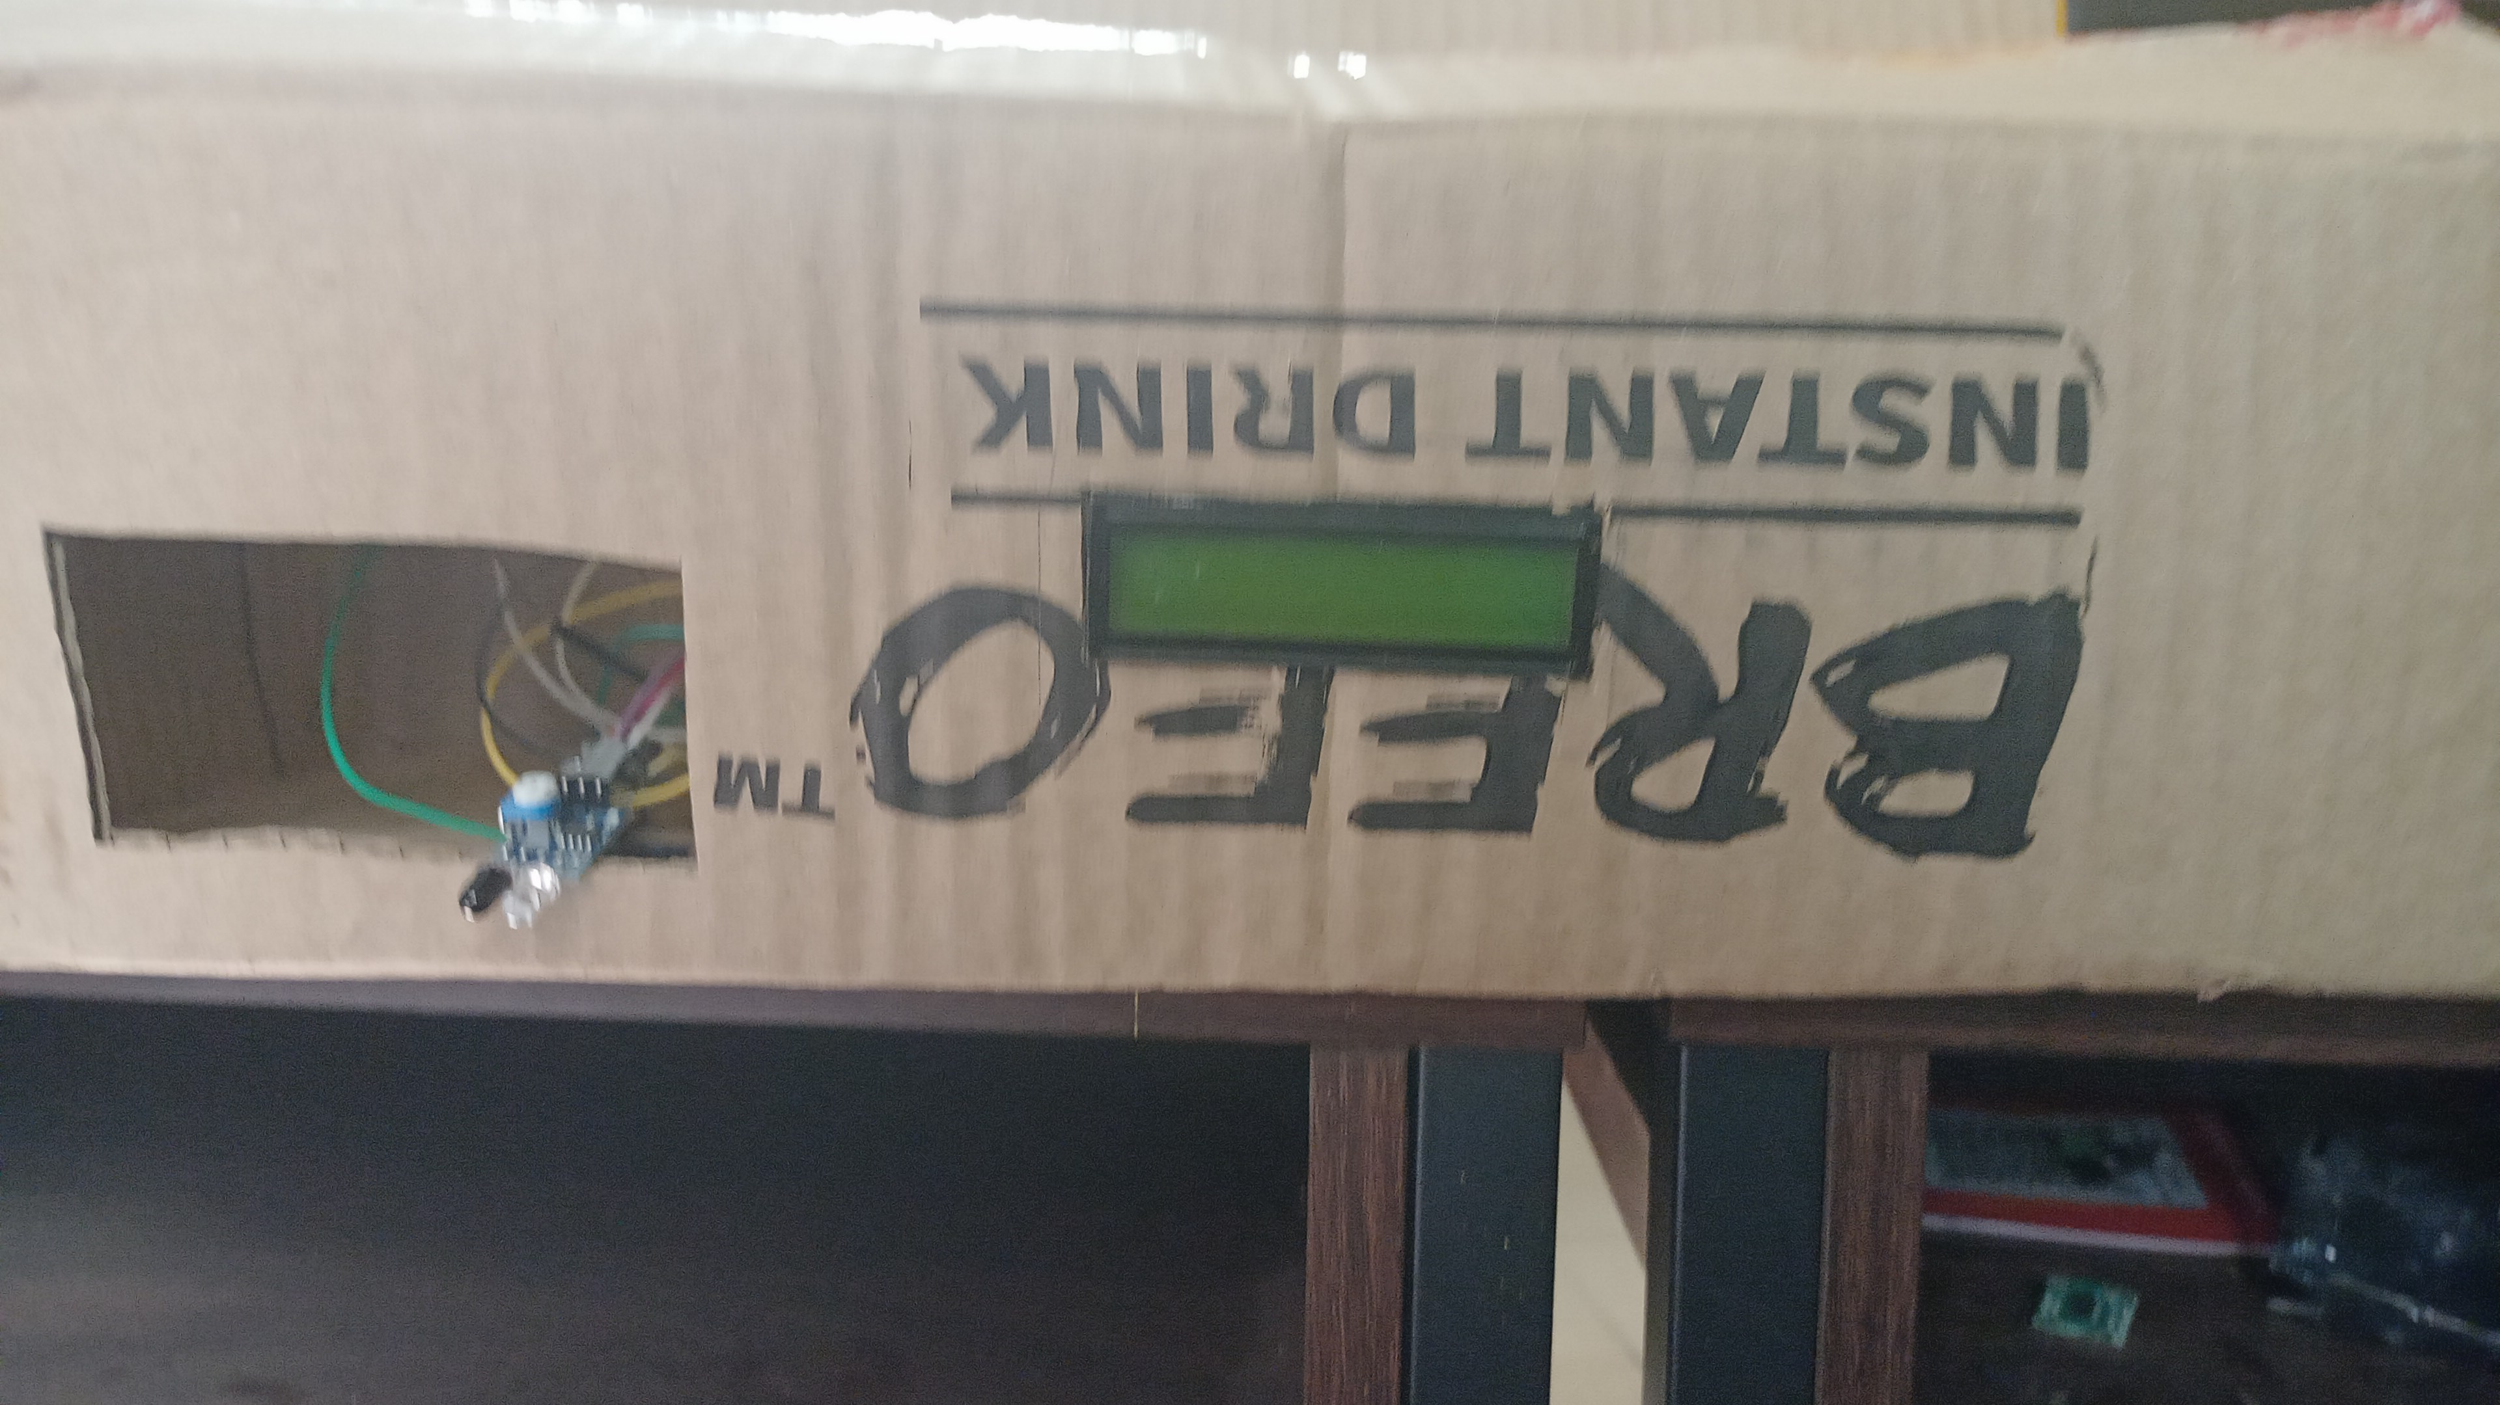
III. BK DIAGRAM
No
Yes
I. INTRODUCTION
In our mission to combat the coronavirus pandemic, we've devised an innovative approach to promote hand hygiene, particularly in areas facing water scarcity. Our solution revolves around a groundbreaking machine that converts water into a mist, facilitating effective hand cleaning while conserving precious water resources. Central to this system is the 89S52 microcontroller, which serves as the backbone, coordinating the operation of essential components like the buzzer, 16x2 LCD, and LED.
Fog Maker On
Dry handwashing machine By Fog Disinfection To Save Water
Om Kaldate , Ram Yalmate , Sudarshan Biradar
SY BTech, AY 2023-24 SEM-II, Course: Microcontroller And Application
Under the Guidance of: Dr. Pravin G. Gawande
Introduction
Block diagram
Results
Write Name of conference where paper submitted
Ensuring proper hand hygiene is paramount in preventing the transmission of diseases, yet traditional handwashing methods often come with a significant water footprint. In regions grappling with water scarcity, this poses a formidable challenge. However, emerging innovations offer promising solutions. One such innovation is the dry handwashing machine utilizing fog disinfection technology. Unlike conventional methods, this system operates without the need for running water, conserving precious resources while maintaining effective hygiene standards. By harnessing the power of fog disinfection, it efficiently eliminates pathogens from hands, offering a sustainable alternative to traditional handwashing. This poster presentation explores the concept of the dry handwashing machine and its potential to revolutionize hand hygiene practices, particularly in water-stressed environments. Through this innovative approach, we aim to address not only the imperative of public health but also the pressing need for water conservation on a global scale.
16 * 2 LCD Display
The implementation of the dry handwashing machine using fog disinfection technology yielded promising outcomes across various settings. In healthcare facilities, where stringent hygiene protocols are essential, the adoption of this innovative solution led to a significant reduction in water usage while maintaining high standards of hand hygiene compliance among staff and patients. Public spaces, such as airports and train stations, also benefited from the convenience and accessibility of the dry handwashing machine, promoting hygiene practices among travelers without exacerbating water scarcity concerns. Furthermore, educational institutions witnessed improved sanitation practices among students and faculty, contributing to a healthier learning environment. Overall, the results demonstrate the effectiveness and feasibility of integrating dry handwashing machines with fog disinfection technology as a sustainable solution to water conservation challenges while prioritizing public health initiatives.
IR Sensor
FAN
Atmega328P
microcontroller
LED
Buzzer
Humidifier Sensor
Methodology
Hardware Setup
Conclusion
Implementing of Contactless Automatic Hand Wash distributor for Sanitation is proficient and the low cost . It works like the regular contactless automatic machine. The human gets the limited antiseptic liquid for sanitation in hand, to wash the hands and to defend themselves from the germs and virus. This system can be utilized in malls, high populated areas , hospitals , schools etc.
it will be enhanced quality when considering the life of the system and the simplicity. The major goal of this seminar was to use current advanced technologies to enlarge an involuntary hand sanitizing machine to improve hygiene and prevent the infectious viruses entering our body. Automatic hand sanitizers are less costly when compared to any other hand sanitizing tools . At the same time it is environment friendly as because the disposable wastage is very low, since it can be refilled easily without any mechanical support. These automatic hand sanitizer machines are developed keeping in mind about its affordability by poor sections of the society as it can be purchased by lower income groups .
STEP 1: Start
STEP 2: Initialize LCD display for showing current status of hand are sanitized or not
STEP 3: Set the input IR for sensing
STEP 4: Check for the activation of Fog Maker.
If the Fog Maker is activated go to step 4 and step 5 otherwise repeat step 3.
STEP 5: The Disinfectant Solution is converted into the Fog.
STEP 6: Fog is transferred to the Hand Chamber.
STEP 7: We are ready to get our Hand Sanitized.
STEP 8: Check for the hand got sanitized by the machine. If the hand is sanitized go to next step.
STEP 9: Turn on the fan for drying hands
STEP 10: When the process is done the machine will stop
STEP 11 : Display the lcd that remove your hands lease remove hands
Step 12: machine waits for 5 seconds for getting system ready and this shows on LCD display
STEP 13: go to step 1
References
Health impact of handwashing. WELL fact sheet 2006. at: http://www.lboro.ac.uk/well/resources/factsheets/fact-sheets htm/Handwashing.
https://www.instructables.com/id/DIY-Easy-NonContact-Automatic-Hand-Sanitizer- Automatichandsanitizer-disp
BRACT’S, Vishwakarma Institute of Information Technology, Pune-48
Department of Electronics and Telecommunication Engineering
(An Autonomous Institute affiliated to Savitribai Phule Pune University)
(NBA and NAAC accredited, ISO 9001:2015 certified)

